Slide 1

Employee Burnout & Attrition Risk Analytics System
A data-driven approach to identifying employees at high risk of leaving — and quantifying the financial impact before it's too late.
PYTHON · POSTGRESQL · POWER BI
BY DEEPANSHU

Slide 2

Project Overview
Unlike traditional HR analysis, this system uses burnout-driven behavioural patterns and predictive modelling to identify attrition risk early — following a structured 3-stage pipeline.
Business Intelligence
Data Management
Data Analysis
Each phase converts raw employee data into actionable risk intelligence for HR teams.

Slide 3
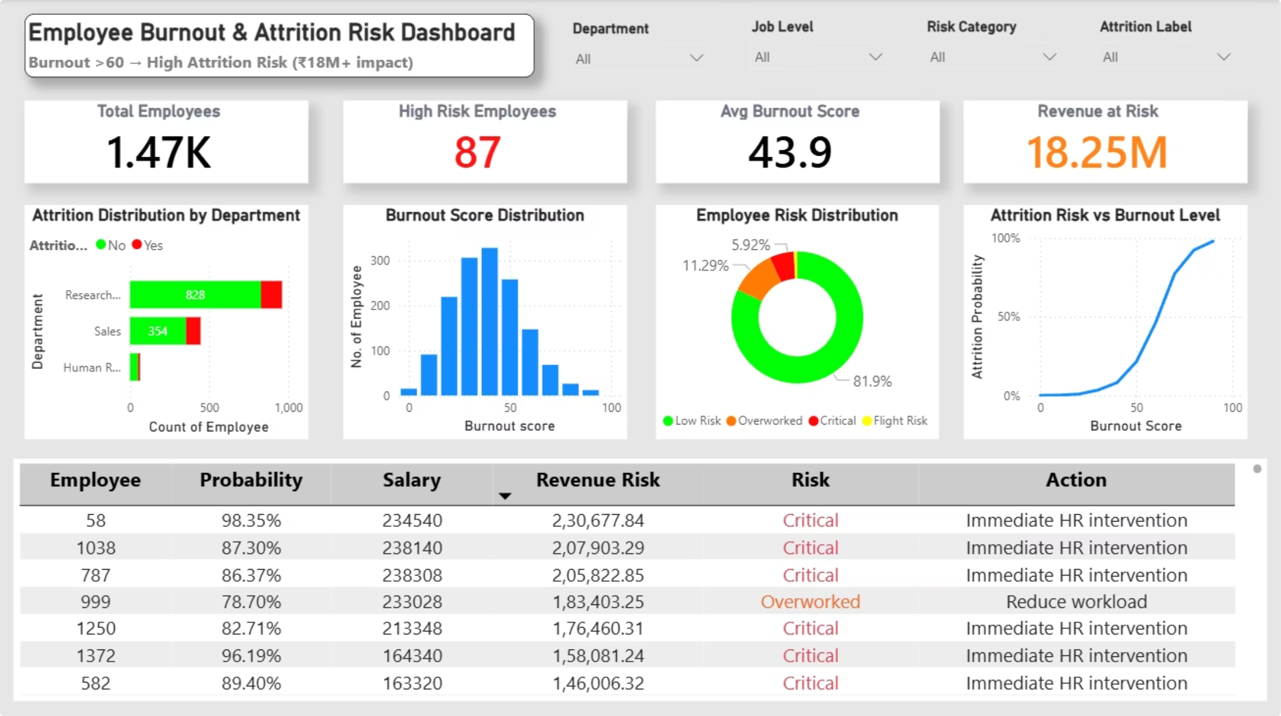

The Dashboard at a Glance
Key Metrics
1.47K
Total Employees
87
High Risk Employees
43.9
Avg Burnout Score
€18.25M
Burnout > 60 → High Attrition Risk (18M+ Impact)
Revenue at Risk

Slide 4

Technology Stack
Jupyter Notebook (Python 3.x)
PostgreSQL (pgAdmin 4)
Power BI Desktop
Structured storage of processed dataset. SQL used for risk-based filtering, department analysis, and validation.
Interactive dashboard with KPI cards, risk distribution visuals, and department analysis. DAX for dynamic calculations.
Data cleaning, feature engineering, and predictive modelling using Pandas, NumPy, and Scikit-learn.

Slide 5
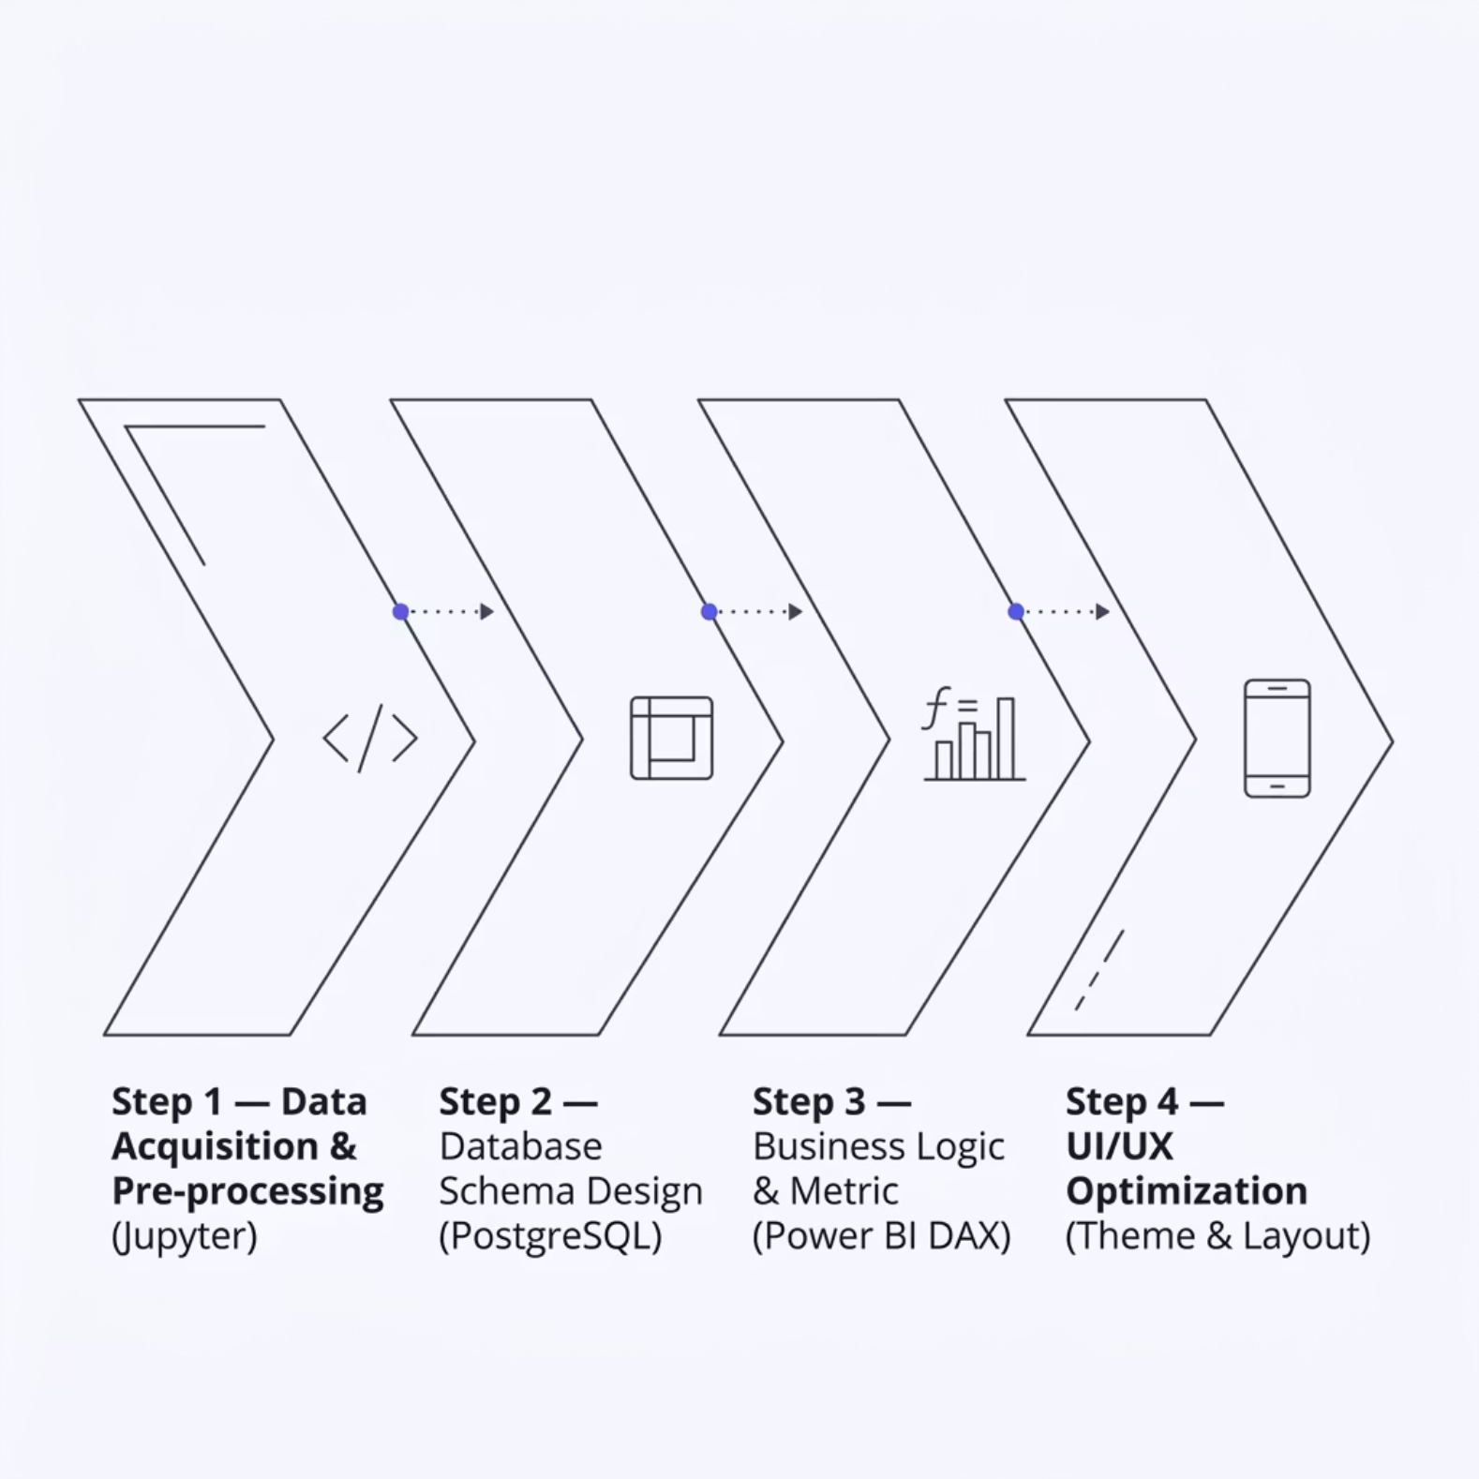

Dataset & Methodology
IBM HR Employee Dataset
~1,470 employees at individual granularity. Key burnout features:
Work hours & meetings per week
Leave balance & engagement score
Target: Attrition (Yes/No)
Employees categorized as: Low Risk · Overworked · Flight Risk · Critical

Slide 6
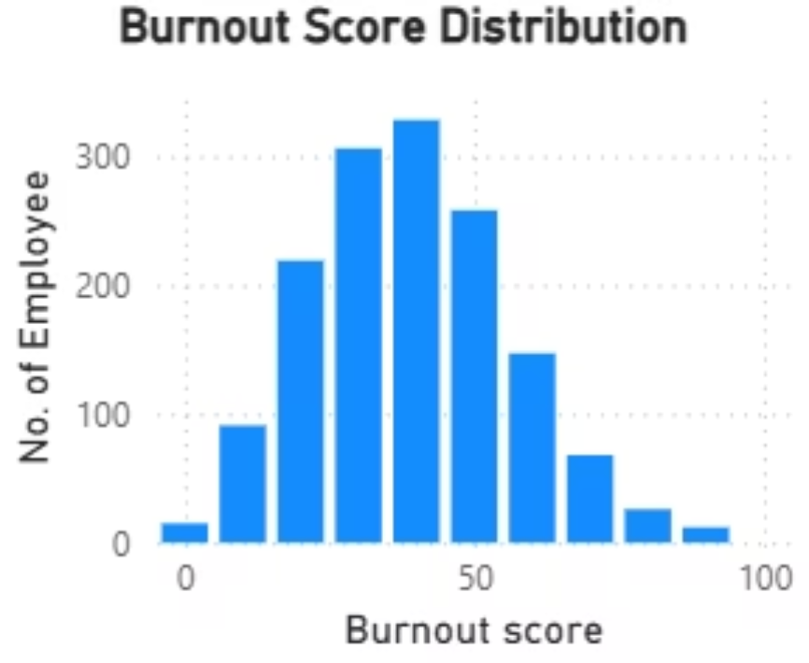
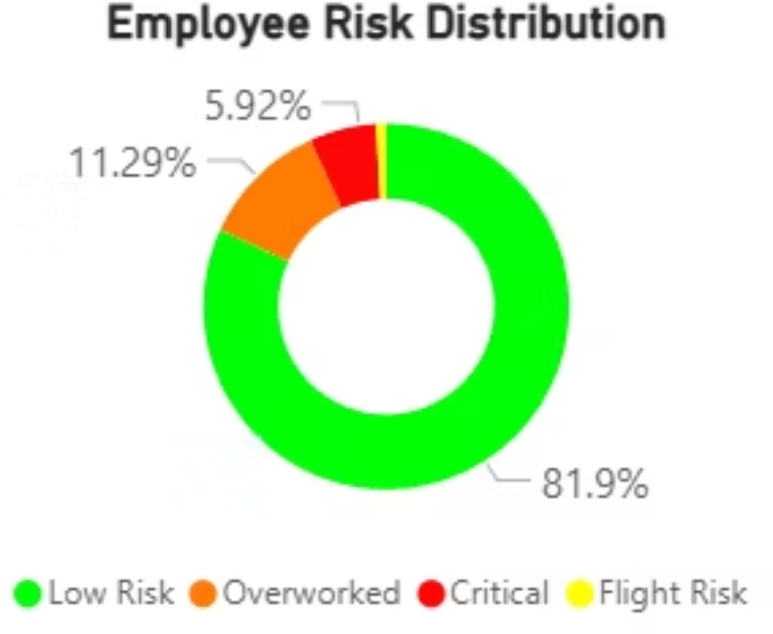
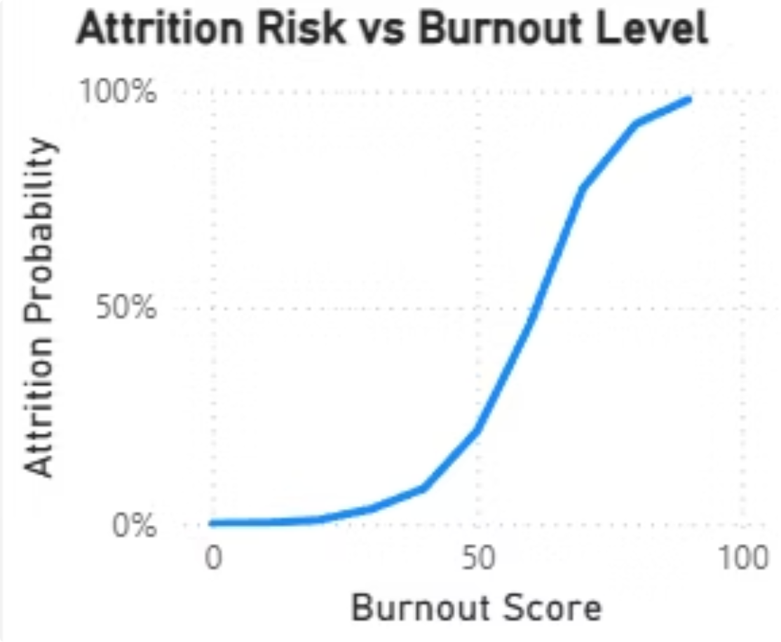
Dashboard Visuals: Risk Distribution
Burnout Score Distribution
Employee Risk Distribution
Attrition Risk vs Burnout
Majority fall in the 40–60 range. A noticeable portion exceeds 60, where attrition risk sharply increases.
81.9% Low Risk · 11.29% Overworked · 5.92% Critical · Flight Risk minimal.
Risk rises slowly until burnout ~50, then increases almost exponentially beyond 60.

Slide 7

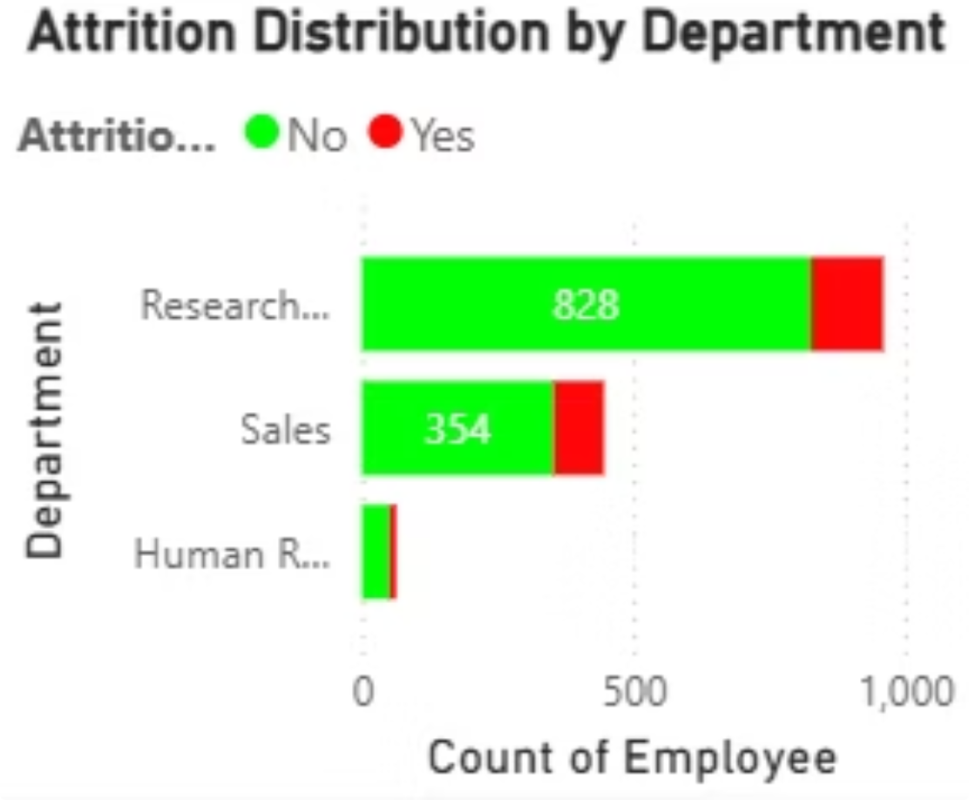
Attrition by Department
1
2
Research
Sales
Largest department (~828 employees) with notable attrition cases.
Higher attrition proportion relative to size — indicating pressure-driven exits.
3
Human Resources
Minimal attrition, suggesting lower workload or better work-life balance.

Slide 8
High-Risk Employee Analysis
Employees with high attrition probability, high salary, and high revenue risk are clearly identified — majority fall under Critical category.
Employee
Probability
Salary
Revenue Risk
Risk
Action
58
98.35%
234,540
2,30,677.84
Critical
Immediate HR intervention
1038
87.30%
238,140
2,07,903.29
Critical
Immediate HR intervention
787
86.37%
238,308
2,05,822.85
Critical
Immediate HR intervention
999
78.70%
233,028
1,83,403.25
Overworked
Reduce workload
1372
96.19%
164,340
1,58,081.24
Critical
Immediate HR intervention

Slide 9
Business Recommendations
Early Risk Intervention
1
Flag burnout score ≥ 60 as priority. Set automated HR alerts.
Target High-Risk First
2
1:1 HR intervention (Critical) · Workload correction (Overworked) · Retention offer (Flight Risk)
Department Optimization
3
Focus on Sales & Research: rebalance workload, reduce overtime, improve team distribution.
Continuous Monitoring
4
Integrate dashboard into monthly HR reviews. Track burnout trends and revenue at risk.
Retention & Policy
5
Incentives + career growth for high-value talent. Limit meetings, enforce work-hour boundaries.

Slide 10


Conclusion
Key Takeaway
Burnout is a strong predictor of attrition — risk rises sharply beyond a threshold level.
By combining Python · SQL · Power BI, this system:
Identifies employees at high attrition risk
Quantifies financial impact (€18M+)
Provides actionable HR recommendations
Shifts HR from reactive → proactive, reducing attrition before it impacts business performance.

